Slide 1
Third Party Vendor Management and Servicer Audits of Your Law Firm:
What To Expect, How to Prepare For It, And The Need For a Consistent Industry Standard
TUESDAY, JULY 22 | BROADMOOR HALL C

Slide 2
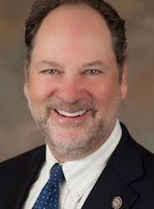
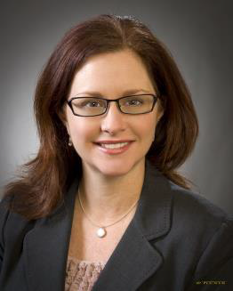
SESSION SPEAKERS
Richard Koch
Senior Vice President
Morningstar Credit Ratings, LLC
richard.koch@morningstar.com
Jordan Dorchuck
Executive Vice President/General Counsel
BSI Financial
jdorchuck@bsifinancial.com
Wendy Anderson
Attorney
Safeguard Properties Management, LLC
wendy.anderson@safeguardproperties.com
Sam Bready
Operations Executive
KML Law Group, P.C.
sbready@kmllawgroup.com
Kelly O'Bannon
EVP Special Servicing
Residential Credit Solutions, Inc.
kobannon@residentialcredit.com

Slide 3
Panel Overview
Auditing of third party service providers: What is the current industry environment?
Is there a need for uniform auditing standards?
Vendor Management: Centralized or de-centralized oversight?
Key selection criteria in selecting a vendor and in evaluating ongoing performance
How to minimize the resource drain and expense of audits?
Regulatory involvement: What is the future state?
Scorecards and benchmarking: What are the key performance metrics that should be included in your service level agreements and in your performance management criteria?
The future outlook for smaller market participants: Attrition vs growth

Slide 4
Questions for the Panelists?
You can submit them by:
Visiting this session’s question link: https://www.polleverywhere.com/free_text_polls/cjplvtcRwF69I3j/web
Texting 590344 and your question to: 22333
Visiting our Poll site for access to all of our Session polls/questions: https://www.polleverywhere.com/alfn
Ask questions or make comments verbally by using the microphones provided in the session room

Slide 5
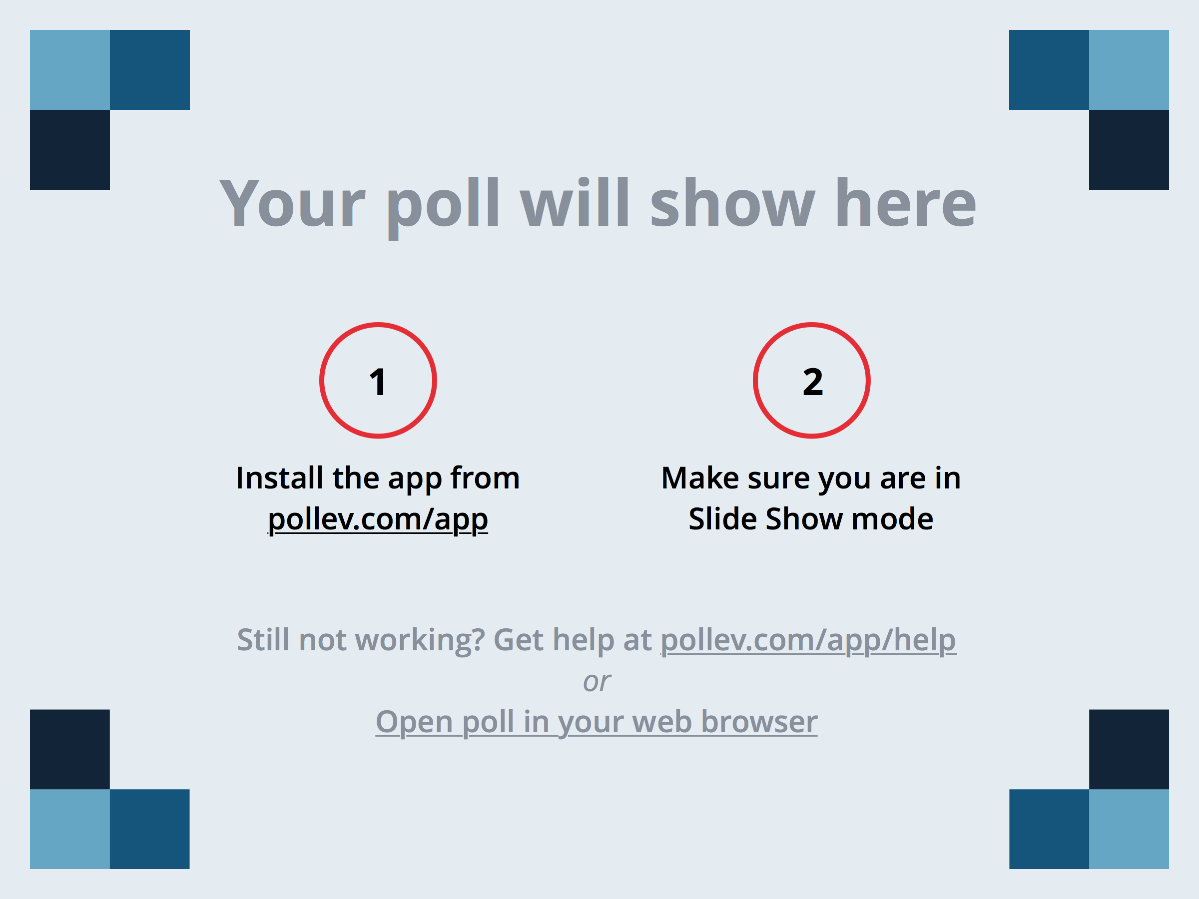
Audience Polling Questions
Notes:
Has your Law Practice undergone a Servicer Audit? https://www.polleverywhere.com/multiple_choice_polls/RQ3rtgQ8nhSkWRo#!/my/polls

Slide 6
Audience Polling Questions
Notes:
As an Attorney/Law Firm, do you believe that there is a critical need for uniformity/standardization in the servicer-vendor audit process? https://www.polleverywhere.com/multiple_choice_polls/xypNHpaa1WL4aks#!/my/polls

Slide 7
Overview
BSI’s Vendor Management program is designed to ensure the right things are done to mitigate unwarranted vendor risk not only for the benefit of BSI but for the consumer/homeowner.
Like any other vendor program best practices were utilized, and modifications were made based on usage. Ongoing evaluation will continue to ensure our program exceeds expectations.
This BSI presentation will be available in the conference notebook for review after the session. This will be a Q & A Panel session and will not necessarily follow the presentation exactly.

Slide 8
Effective Vendor Program Relies On
Development of clear and concise Vendor Management Policies and Procedures.
Defined roles and responsibilities of stakeholders in the process.
Communication with internal business managers/sponsors.
Collaboration with proposed/existing vendors.
Clear definition of expectations for due diligence and documentation.
Effective vendor evaluation process.
Defined contractual expectations.
Ongoing monitoring and auditing process.
Vendor Contingency Plan.

Slide 9
Policies and Procedures
Clear understanding from the employees is essential to ensuring the success of any program.
The Policies and Procedures were the initial step and:
Designed to provide insight into the overall process and provides a framework of understanding.
Ensures guidance for the rational behind the need.
Explains classifications of risk along with Federal Regulations
Details step by step processes from vendor selection to contract execution.
Informs of ongoing requirements and continuing refresher training of staff.

Slide 10
Roles and Responsibilities
Identify those that have a stake in the process.
Clearly define roles and requirements.
What is expected of me or my group?
Map out the process.
When and where do you fit in.
Work together to assign specific functions in the process.
Collaborative effort amongst business.
Involvement helps ensure buy in.
Clear and consistent communication.
Constant evaluation of the process.
Determine if working/not working.
Looking for efficiency without sacrificing thoroughness.

Slide 11
Internal Communication
Like any program and/or process, success or failure lies with an effective communication program.
When possible meet in person with those who are involved in the process.
Email is easy on both ends but less effective.
Hard to ignore someone in front of you.
Provides the ability to focus on the other person and Listen.
Listening is a lost art but if done effectively brings value and acceptance.
Great ideas and innovations to processes come from active listening.

Slide 12
Collaboration with Proposed/Existing Vendors
KNOW YOUR VENDOR.
If a proposed/new vendor or existing vendor do some research.
Know their products
Know their offerings
Know the contacts
Actively listen to them
Ensure their values align with the company values/goals
Look for potential issues that could derail the process.
Communicate
Teamwork

Slide 13
Define Due Diligence and the Need for Documentation
Standard list of questions to be addressed by the vendor on an annual basis.
Questions based on but not limited to:
IT
Security
HR
Compliance
Examples of documents needed by the vendor on an annual basis.
Insurance Coverage
Financials
Business Continuity Plan
Disaster Recovery Plan
Information Security Policy
Data Retention Policies
SAS 70
Policies/Procedures
Operations and Controls
Training

Slide 14
Evaluation Process
Analyze the information provided.
Look for Red Flags
Bankruptcy filings
Employee turnover
Client turnover
Leadership and strategy changes
Provide documents to key stakeholders for their expertise:
IT
HR
Business Manager/Sponsor
Senior Management
Documents maintained in specific location

Slide 15
Vendor Selection
Based on best overall package
Quality of information and documents received
Risk Assessment
Reputation and past performance
References (not just ones provided)
Pricing (Lowest not always best or only criteria to use)
Business fit

Slide 16
Defining Contractual Expectations
Clear expectations of each entity and outlines services provided
Contract termination date
Privacy and regulatory expectations
Termination and renewal dates along with period of notice
Consequences for non compliance
Insurance coverage requirements
Rights to audit and request documentation

Slide 17
Vendor Contingency Plan
Concerns identified and not corrected
Quality, timeliness
Non compliance with rules and regulations to include contract
Significant reputation concerns
Being investigated
Fannie Mae cutting ties
Notification provided through email, calls, scorecards
Meeting held to discuss issues
Initiate transition plan
Vendor selection and new contract
Contract Termination if warranted

Slide 18
Vendor Classifications and Risk Assessment
Determine the nature of the vendor.
Conduct a risk assessment of the vendor.
Assessment determines the criticality of the vendor.
Critical
Moderate
Minor

Slide 19
Critical Vendors
Have a significant impact on the business.
Relied on heavily.
How would the work continue if there were issues with the vendor?
Rank vendors based on Risk Assessment.
Critical vendors ongoing monitoring to include:
On-site yearly audit
Provide required documentation
Complete questionnaire
Periodic evaluations and constant communication
Ongoing contract monitoring

Slide 20
Moderate & Minor Vendors
Have an impact and relied upon by the business
Based on quantity of work and nature of business.
Ranked based on Risk Assessment
Moderate & Minor Vendors undergo monitoring which includes:
Yearly desktop audit
Provide required documentation
Complete questionnaire
Periodic evaluations and communication
Ongoing contract monitoring

Slide 21
On-Site Audits
Conducted on a yearly basis or based on specific need.
Inform vendor of visit in advance and prepare them for requirements
Obtain documents and completed questionnaire in advance
Review and formulate follow-up questions prior to audit
If something is missed address it.
Discuss process/procedures, evaluate and tour the facility
Look for what has been discussed:
Security such as cameras, motion sensors, locked areas (restricted access)
IT and software usage
View technology used
Implemented procedures and processes
End of audit discussion and evaluation.
Discuss good and what is lacking.

Slide 22
Desk Top Audits
Conducted on a yearly basis (minimum) and/or based on specific need
Inform vendor in advance of sending out audit packet
Inform them of requirements to fill in questionnaire and provide documents
Evaluate what was received from Vendor
Provide pertinent documents to other internal stakeholders
Discuss questions or concerns with vendor
End of audit discussion and evaluation.

Slide 23
Vendor Scorecard
Rating of vendors from Fully Meets to Unacceptable.
Evaluated based on:
Overall Performance
Service Evaluation
Pricing
Delivery
Quality
Results provided to vendor and if needed discussion held.

Slide 24
Servicer Audits of Law Firms – Due Diligence & Performance Reviews
Creation of Legal Services Agreement or validation that a Legal Services Agreement exists and is signed.
Ongoing Due Diligence and Performance Reviews.
BSI’s Foreclosure and Bankruptcy Department provides oversight of relationships and assists Vendor Management in conducting Due Diligence.
BSI’s Foreclosure and Bankruptcy Department provides periodic performance reporting (via scorecard) to Vendor Management.
Annual verification the license is in good standing.
Validate proper insurance is in place.
Annual onsite audits for those law firms that have had 100 or more referrals in a calendar year from BSI.
Other law firms with <100 referrals in a calendar year have Annual Desktop audits completed.

Slide 25
Servicer Audits of Law Firms – Ongoing Comprehensive Monitoring
BSI’s Foreclosure and Bankruptcy Department monitors all foreclosure and bankruptcy firms.
BSI’s Foreclosure and Bankruptcy Departments produce scorecards regarding vendor’s service and submit to Vendor Management for record keeping.

Slide 26
Servicer Audits of Law Firms – Termination and Case Transfers
BSI’s Foreclosure and Bankruptcy Department determines if formal termination is needed
Notification to Legal and the Vendor Management Department
Vendor Management to ensure Termination Agreement is filed in vendor file
New vendor assigned to the loan and the service is transferred to the new vendor

Slide 27
Working together for a common goal: “To make the financial services market better.”

Slide 28
Questions for the Panelists?
You can submit them by:
Visiting this session’s question link: https://www.polleverywhere.com/free_text_polls/cjplvtcRwF69I3j/web
Texting 590344 and your question to: 22333
Visiting our Poll site for access to all of our Session polls/questions: https://www.polleverywhere.com/alfn
Ask questions or make comments verbally by using the microphones provided in the session room

