Slide 1

CFPB – A Reality Check
Servicer best practices for overcoming operational and legal challenges as we work through the morass that is the CFPB regulatory environment.
TUESDAY, JULY 22 | 4:15 – 5:15 PM | BROADMOOR HALL C

Slide 2






Speakers
Matthew C. Abad, Esq.
Director Default Operations -
Foreclosure & Bankruptcy
Kluever & Platt, LLC
Alicia Wood
Vice President, Foreclosure- Bankruptcy and Collateral
Residential Credit Solutions, Inc
Benjamin Gottheim
Director -
Mortgage Servicing Policy
Freddie Mac
Jonathan Patrick Sellers, Esq.
Associate Attorney
Mackie Wolf Zientz & Mann, P.C.
Leesa Logan, Esq.
VP Corporate Counsel and Compliance Attorney
Statebridge Company
Sasha M. Cohen, Esq.
Corporate Counsel
Bayview Loan Servicing, L.L.C.

Slide 3
Questions for the Panelists?
You can submit them by:
Visiting this session’s question link: https://www.polleverywhere.com/free_text_polls/g0TjCjaQlfC0kIY/web
Texting 591675 and your question to: 22333
Visiting our Poll site for access to all of our Session polls/questions: https://www.polleverywhere.com/alfn
Ask questions or make comments verbally by using the microphones provided in the session room

Slide 4
Background
Greater scrutiny
Interagency Review Consent Orders
OCC Guidance
AG actions – NMS Settlement
Notes:
Scrutiny, Public/Media, Regulatory Agencies, Capital Hill; * Emergency Economic Stabilization Act/Dodd Frank/Helping Families Save their Homes Act

Slide 5
Expectations
Confusion over Timing
Eg. RESPA – QWR
  OLD – 20/60 day paradigm
  Catalan v. GMAC 629 9F.3d 676
  NEW – 5/30 (15 day extension)
  When did it go into effect
    No one was sure
    Many implemented immediately
    Actual date was the recent January new rule date
Notes:
If you go to the website, there are numerous rule proposals, rules, changes to the rules, it is very hard to track and follow, a compliance nightmare

Slide 6
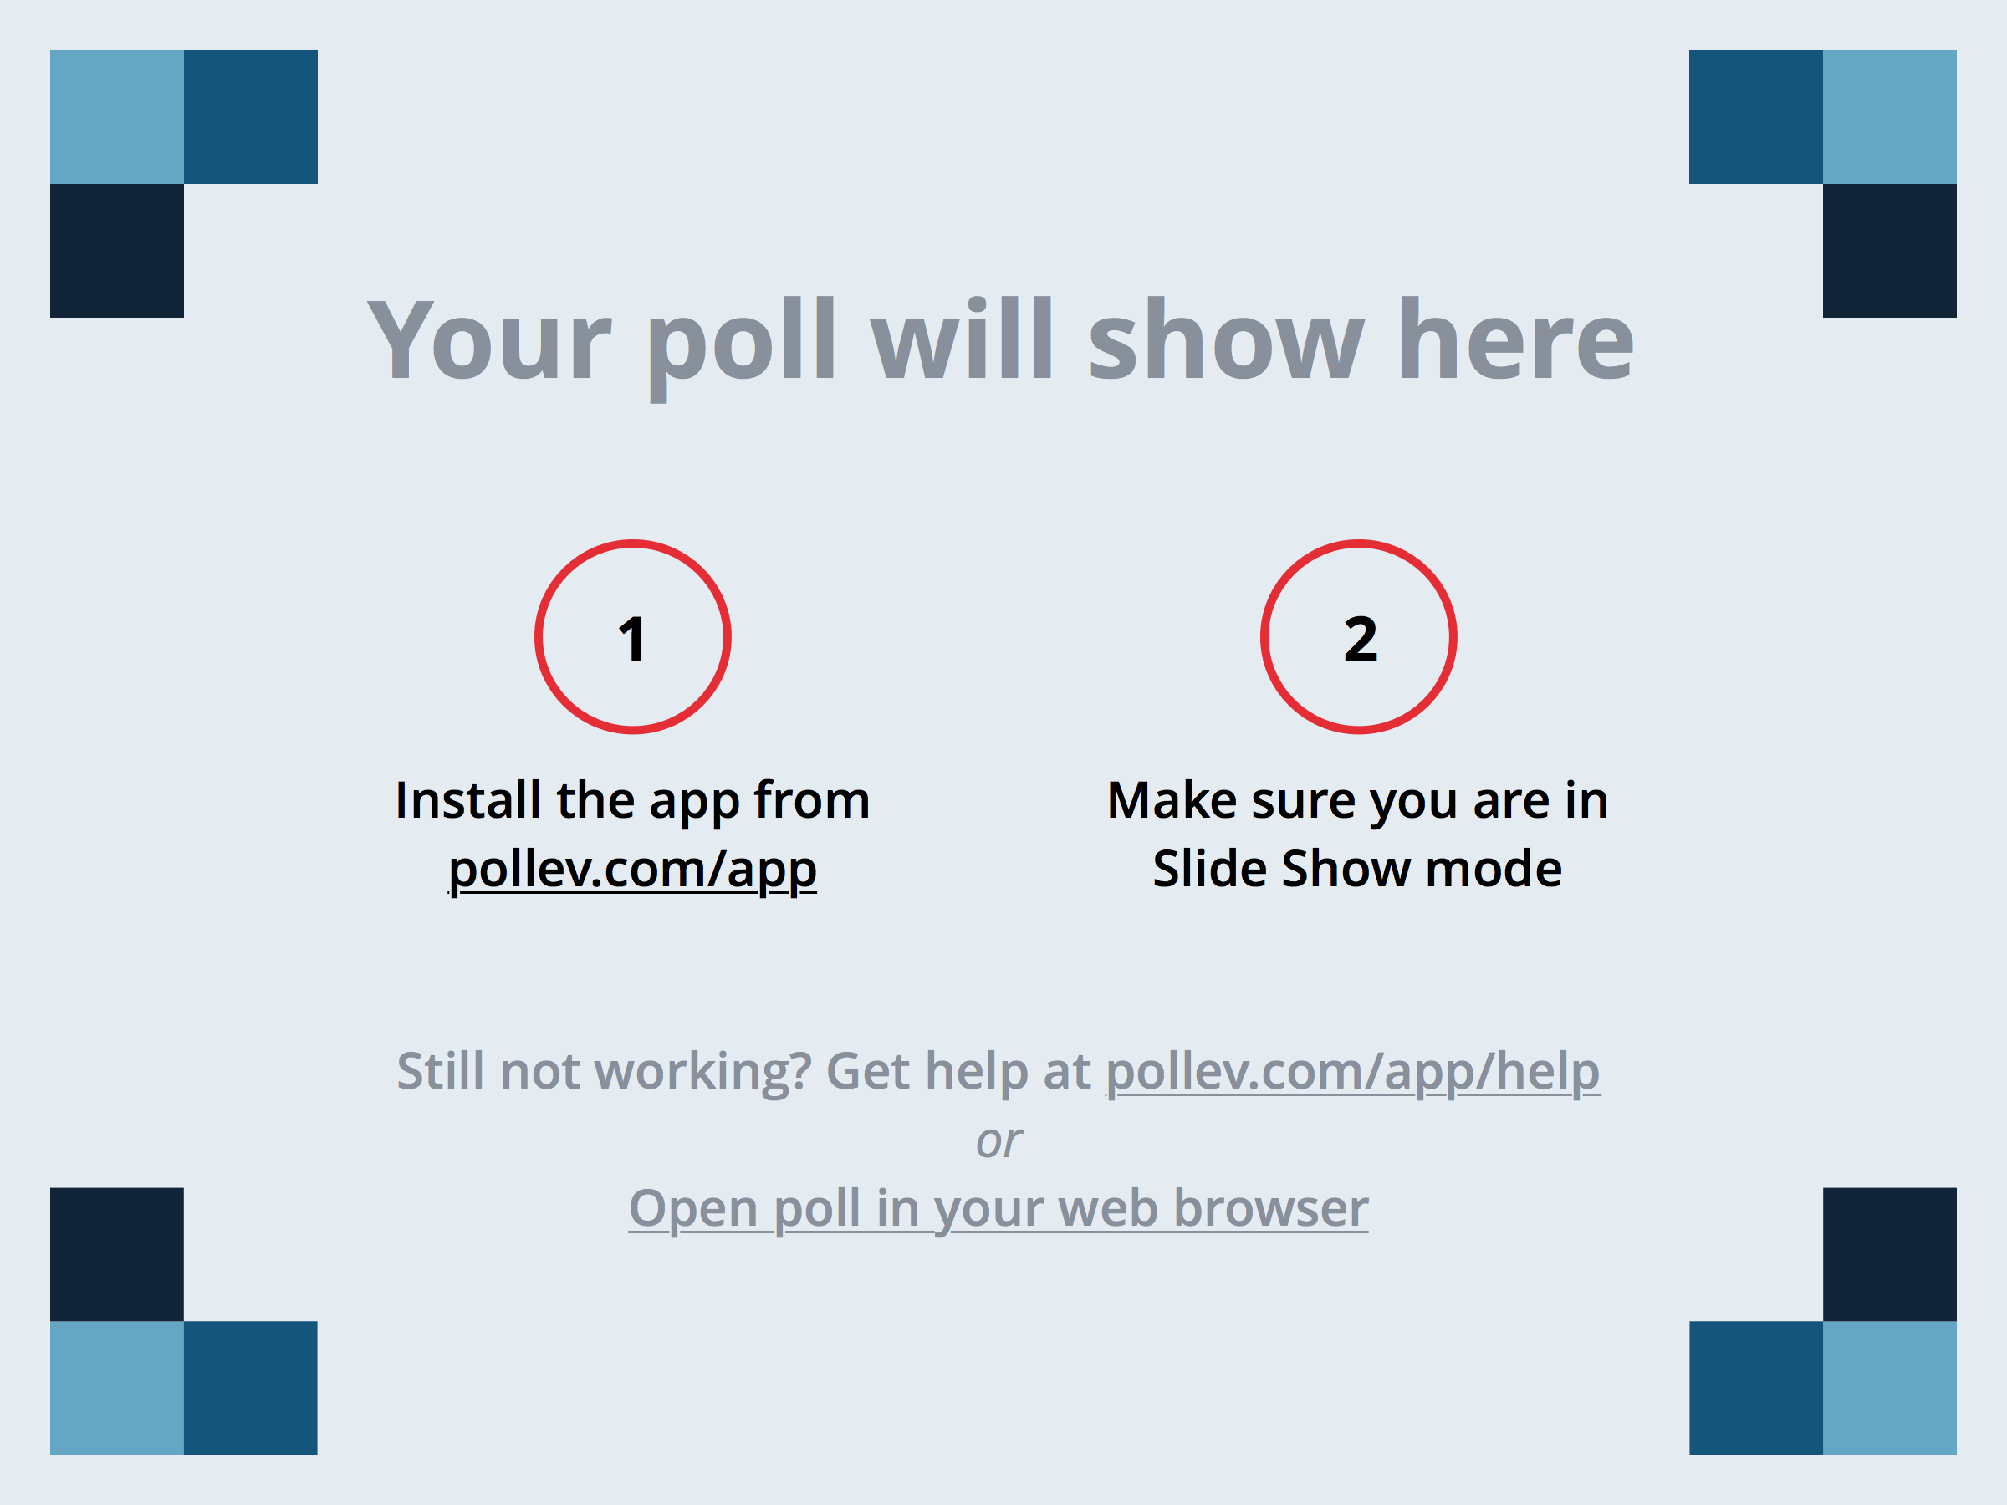
Expectations
Notes:
Based on what happened between the passage of Dodd-Frank, and the implementation of the new rules, the changes were:
https://www.polleverywhere.com/multiple_choice_polls/IQL0g0uSCuQ2Xw3

Slide 7
Changes and How We Avoid Risk
12 CFR 1024.41 (f)
  120 Days delinquent
  FNMA/FHLMC/FHA
  NMS 14 day DOJ Letter
  State Law requirements

Slide 8
Changes and How We Avoid Risk
Be Afraid - CFPB has repeatedly shown its intent
  Views Expressed by the CFPB about the industry
  Aggressive interpretations
  Enforcement Actions (Firms and Servicers)
PRACTICE TIP
#1 - MONITOR THE CFPB WEBSITE
#2 - CLIENT ALERTS (get them to the firms)
Notes:
CFPB v Frederick J Hanna & Associates, P.C. filed on 7-14-14 in ND of GA, Atlanta Div

Slide 9
Changes and How We Avoid Risk
Aggressive in its Rule Making
  Changes the Way Rules are Made
  Number and Frequency of the Rules Promulgated
January 12, 2013 Mortgage Servicing Final Rule
  Implements Dodd-Frank sections addressing servicers’ obligations
  Correct errors, information requests
  Forced Place Insurance Protections

Slide 10
Changes and How We Avoid Risk
Aggressive in its Rule Making(& Enforcement)
  Changes the Way Rules are Issued
    Pre-CFPB – final rule published in Federal Register
    As 12-28-12 – final rule considered issued at earlier
      Publication in Federal Register
      Posting on CFPB Website
  Number & Frequency of the Rules Promulgated
    2012 - 19 Final Rules
    2013 – over 30 plus

Slide 11
Changes and How We Avoid Risk
Borrower Request for Info on Payoff Figures
  Old TILA Standard – Reasonable time
  12 CFR 1026.36(c)(3) – never more than 7 days
PRACTICE TIP
#1 - Documented process & procedure
#2 - Get figures/prepare and send; or
#3 - Make sure client receives request ASAP

Slide 12
Changes and How We Avoid Risk
Error Notices or Requests:
Notices of Violation of Loss Mitigation rules
Respond at the earlier of:
  30 days from the date of the sale, or
  before the foreclosure sale, whichever is earlier
Contact information for owner or assignee
  10 days

Slide 13
Changes and How We Avoid Risk
Error Resolution and QWR
  Catalan v GMAC – Regulator could be agent for receipt of QWR
  Could law firm receipt of request for info be a QWR Trigger
PRACTICE TIP
#1 – Automatic Acknowledgement of Request
#2 – Tip up for Response within 30 days
#3 – Advise of need for additional time before 30 days

Slide 14
Changes and How We Avoid Risk
Dual Tracking Prohibitions
If a Borrower submits a complete Loss Mit
  Must be reviewed
  Decision – accepted/denied
  Prohibited from Proceeding to
    Judgment
    Sale

Slide 15
Changes and How We Avoid Risk
Special Sale Issues for Complete Packages submitted before sale
Review/decision requirements depending on timing
  90 days or more before sale – servicer must give borrower 14 days to accept/reject
  90 days or more before sale – must comply with appeal process
  90 days before sale – servicer must give 7 days to accept/reject
  45 days before sale – acknowledge receipt within 5 days
  37 days before sale – decision within 30 days
Denial Notices must:
  State the reason for denial
  The deadline for appeal if the application was received more than 90 days before sale

Slide 16
Changes and How We Avoid Risk
Notes:
What is the hardest part to comply with and avoid risk going forward?
https://www.polleverywhere.com/multiple_choice_polls/6dSOUCYqU1mnO7K#!/my/polls

Slide 17
SAMPLE: U.S. Bank vs. [NAME] 13-CH-[NUMBER]
Dear Attorney:
The recent amendments to Regulations X and Z, which became effective on January 10, 2014, require that any Request for Information, Notice or Error, or Qualified Written Request be served to the designated address of the loan servicer for such documents. This is a service of process rule and the Regulations make it clear that these documents are not properly served without delivery to such address.
As attorney for US Bank, will you accept service of this process for US Bank? If you will, please sign the form below and return.
If you will not accept service, we will serve these documents pursuant to the Regulations and forward a courtesy copy to you.
We appreciate your anticipated immediate attention to this request. However, should we not receive a reply within three (3) business days of this communication, we will presume you do not wish to accept service, and that our firm is authorized to effect service directly.
My firm will accept service of process ________________________ _________________
(Attorney signature) (Date)

Slide 18
SAMPLE of Opposing Counsel Request for Acceptance of a QWR, Request for Info or Notice of Error
***These are not QWR’s, requests for information or a notice of error.
The debtor attorney wants us to sign and accept on our client’s behalf, a future QWR, notice of error, or request for information on behalf of our client. QWR, Notice of Error and Request for Information are very specific items under the new CFPB Reg X/Reg z rules that went into effect on 1-10-14. They trigger very specific timeline components.
We are not authorized to accept service of these items on behalf of our clients.
Our clients usually have specific, or should have specific addresses set up for those types of requests.
As our clients are represented by counsel (us), we take this as an opportunity to tell opposing counsel;
1 – we do not have authority to accept service of such an item;
2 – that our clients are represented;
3 - the professional rules of responsibility prohibit the opposing counsel from contacting out client, even to deliver such a QWR, Notice of Error, or Request for information; and
3 – we appreciate a courtesy copy of whatever the borrower sends into the client

Slide 19
Conclusion
Questions & Concluding Remarks

Slide 20
Questions for the Panelists?
You can submit them by:
Visiting this session’s question link: https://www.polleverywhere.com/free_text_polls/g0TjCjaQlfC0kIY/web
Texting 591675 and your question to: 22333
Visiting our Poll site for access to all of our Session polls/questions: https://www.polleverywhere.com/alfn
Ask questions or make comments verbally by using the microphones provided in the session room

